Slide 1



Slide 2
Agenda
Ingest Pipeline
Ingest Pipeline v. Logstash Pipeline
SLOs

Slide 3
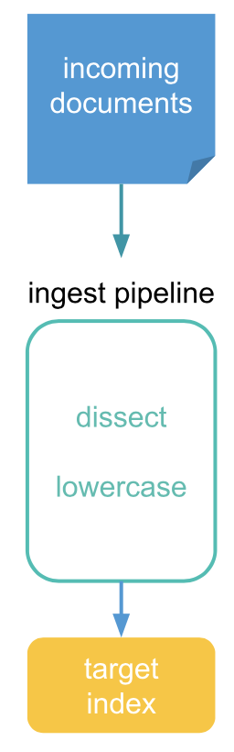
Ingest Pipeline
Allows documents to be transformed before being indexed into Elasticsearch
An ingest pipeline consists of a series of configurable tasks called processors
Each processor runs sequentially, making specific changes to incoming documents
After the processors have run, Elasticsearch adds the transformed documents to an index or data stream
Node with an ingest role handles the pipeline processing
For heavy ingest loads, a dedicated node for ingest is recommended
Deployment:
Elastic Agent
Beats
REST API

Slide 4
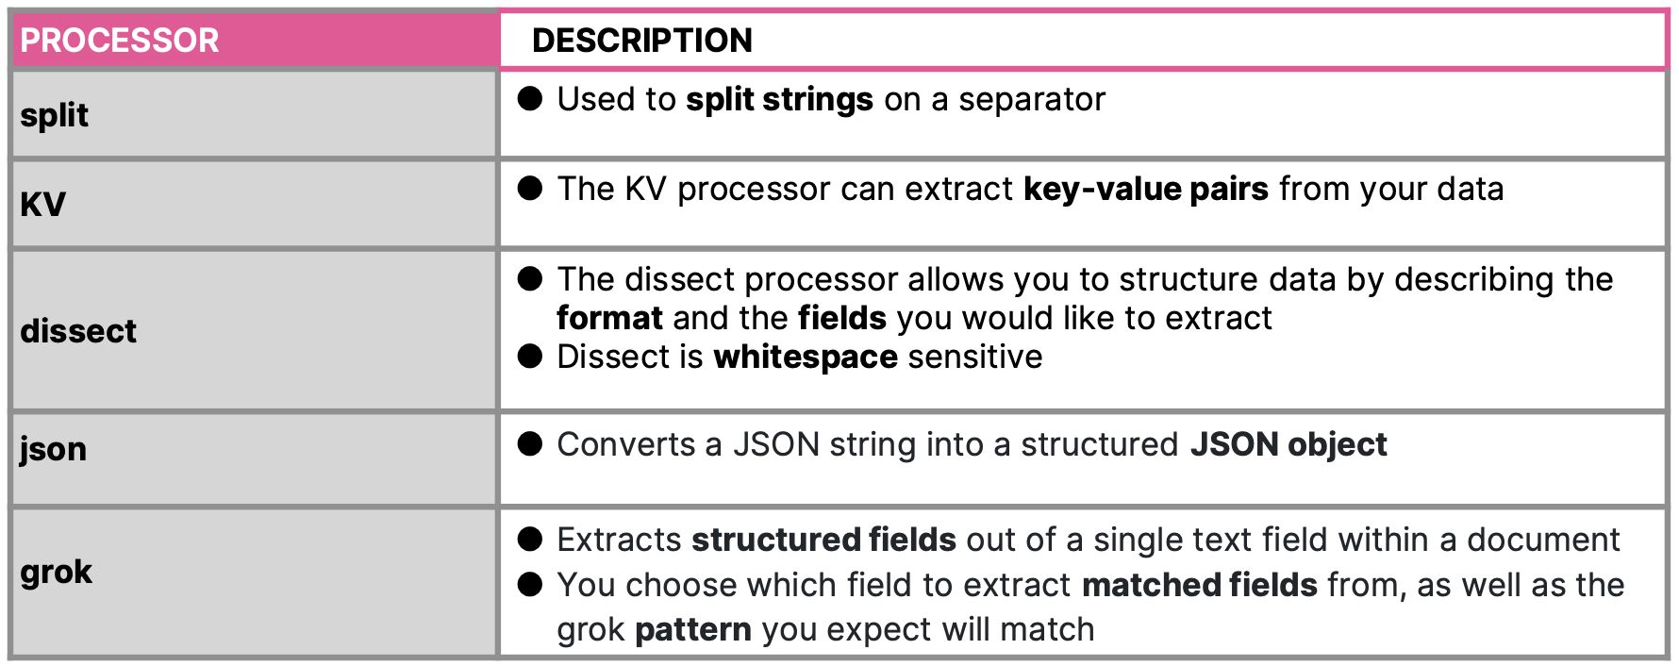
Ingest Pipeline: Processor
Used for parsing and structuring data

Slide 5
Ingest Pipeline v. Logstash Pipeline (Instanda Use Case)
Feature | Option #1 (Ingest Pipeline) | Option #2 (Logstash Pipeline)
Ingestion Method | Elastic Agent | Logstash
Pipeline Configuration | Single Ingest Pipeline, but with multiple pipeline processor (depends on the number of Event Hubs) | Separate Logstash Pipeline for each Event Hub input
Pipeline Maintenance | All event parsing, transformation, and routing logic is concentrated in one pipeline. This requires careful pipeline design so that updates for one Event Hub do not inadvertently affect parsing for others. | Each Event Hub gets its own pipeline, making it easier to update, test, or roll back changes per source without impacting others.
Error Handling | Per document only | Per pipeline and can be monitored (with out-of-the-box Dashboard) via the Logstash integration
Conditionals Support | If | If/Else blocks
Re-ingestion of Failed Documents | N/A | Yes, natively supported via Dead Letter Queue (DLQ)
Index Template | 1 Index Template for EACH Event Hub input
Data Stream | 1 Data Stream for EACH Event Hub input, with the namespace serving as the differentiator.
Parsing Ability | Minimal | Higher (e.g. adding new fields with conditions, parsing nested fields)
Operational Burden | VM where Elastic Agent will be hosted | VM where Logstash will be hosted, but requires higher specs

Slide 6
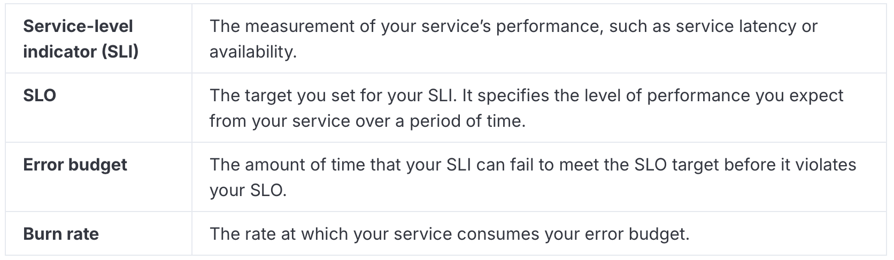
SLOs
Define clear, measurable targets for service performance, based on factors such as availability, response times, error rates, and other key metrics
Can be created using various data sources, including custom KQL queries or APM latency
Important Concepts:
Requires the following minimum requirements:
Platinum license
An Elasticsearch cluster with both transform and ingest node roles present
SLO user and role access

Slide 7
Thank you

